Slide 1

Unit 1 Food matters
Reading (II)
周奇志 株洲市九方中学

Slide 2

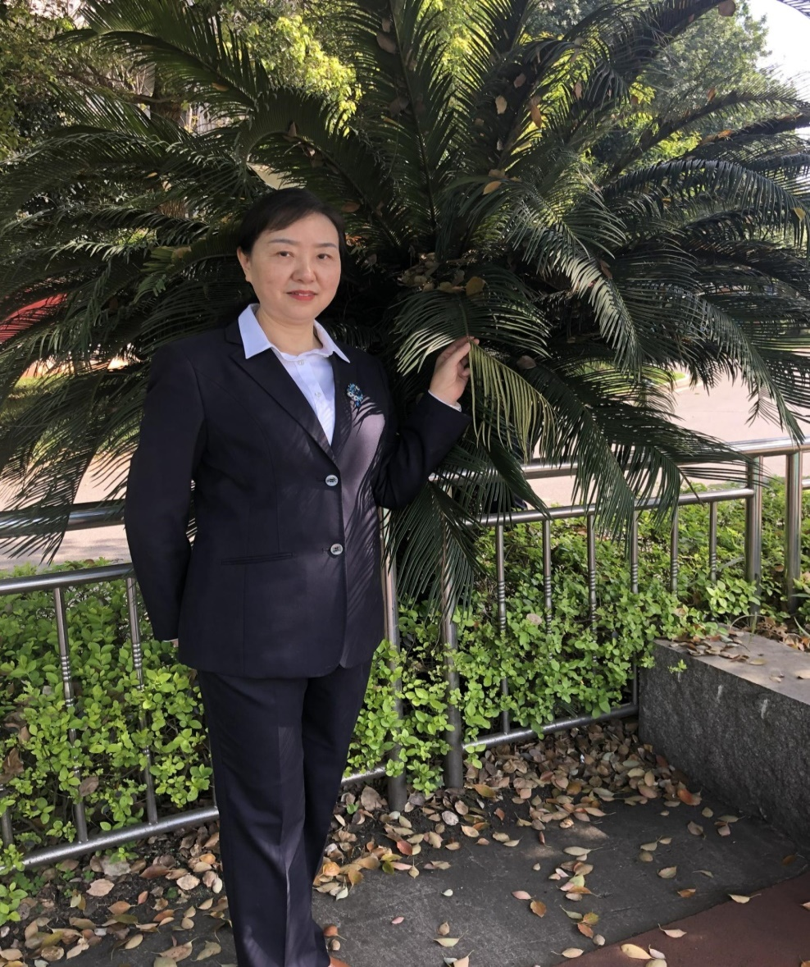
周奇志
湖南省英语特级教师
株洲市百优教师
株洲市教学视导专家组成员
株洲市九方中学教研组长

Slide 3
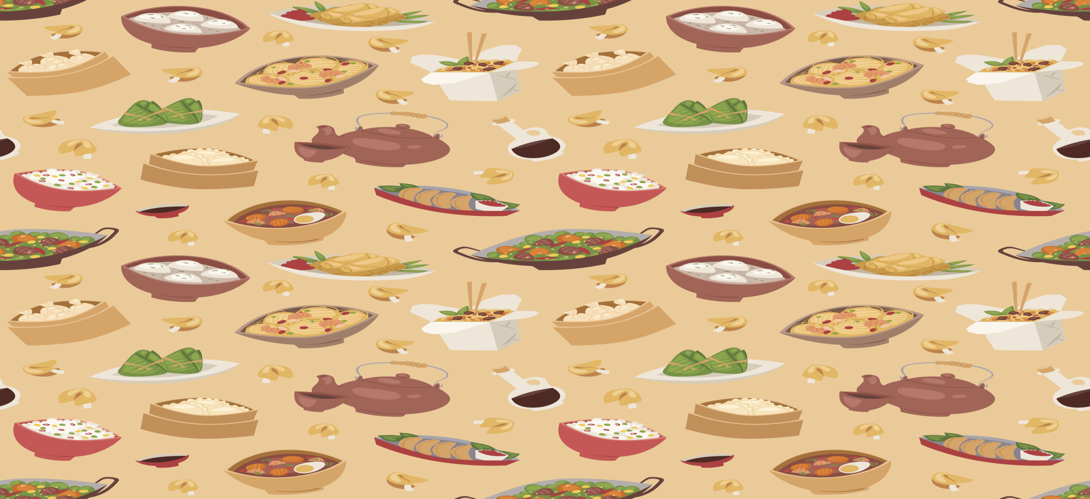
warming up
What do you think of
the comfort food?

Slide 4


Have a free talk
Comfort food makes me think of my memories from my sunny childhood.
Comfort food makes us feel better, it makes up for bad feelings.
Comfort food helps us recall happy memories.
Comfort food takes us back to our culture roots, giving us “ the taste of home”.
Comfort food is good food for soul …

Slide 5

Building your language
Parts | Words | Phrases | Sentences
Para. 1
Para. 2
lift my spirits, do the trick, transport me back to,
take my time
...
I take my time over every spoonful, gently rolling the silky dessert around my mouth and ...
recipe, greedily, dessert, flavour, combination
...
in its broadest
sense,
refer to, lie in,
call to mind,
make up for
...
We will talk about a particular type of comfort food whose power mainly lies in the associations it calls to mind ...
illustrate, association
...

Slide 6


Building your language
Para. 3
Para. 4
Para. 5
vary from ... to ..., depend on, shape our lives, be linked with, tied up with, cheer sb up
...
We often connect chicken soup with a happy childhood and its flavor becomes tied up with the feeling of being taken care of.
vary,
link, emotion
...
One mouthful of comfort food takes us back to our cultural roots, giving us the “taste of home” that we cry out for and relieving feelings of homesickness.
vinegar, salty, relieve
...
cry out for,
give up,
take back to,
relieve feeling of
...
Comfort food tastes good and by building an emotional bond with our happy memories, always makes us feel good.
bond
...
build bond with,
make us good
...

Slide 7
Expressions with similar meanings
to make sb think of sth | to make sb feel better
transporting me back to (page 2, line 5) | lift my spirits (page 2, line 3)
calls to mind /recall (page 2, line 14) | makes up for bad feelings (page 2, line 14)
unlock memories of (page 3, line 21) | cheers us up (page 3, line 22)
takes us back to (page 3, line 31) | reliving feelings of (page 3, line 32)

Slide 8
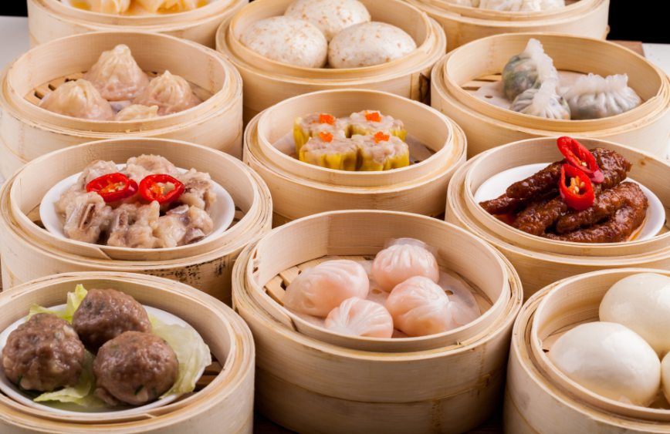
Learning to use
Breakfast is an important meal but what people eat for breakfast is highly individual. People tend to eat different things for breakfast, depending on where they come from and what eating habits they have.

Slide 9
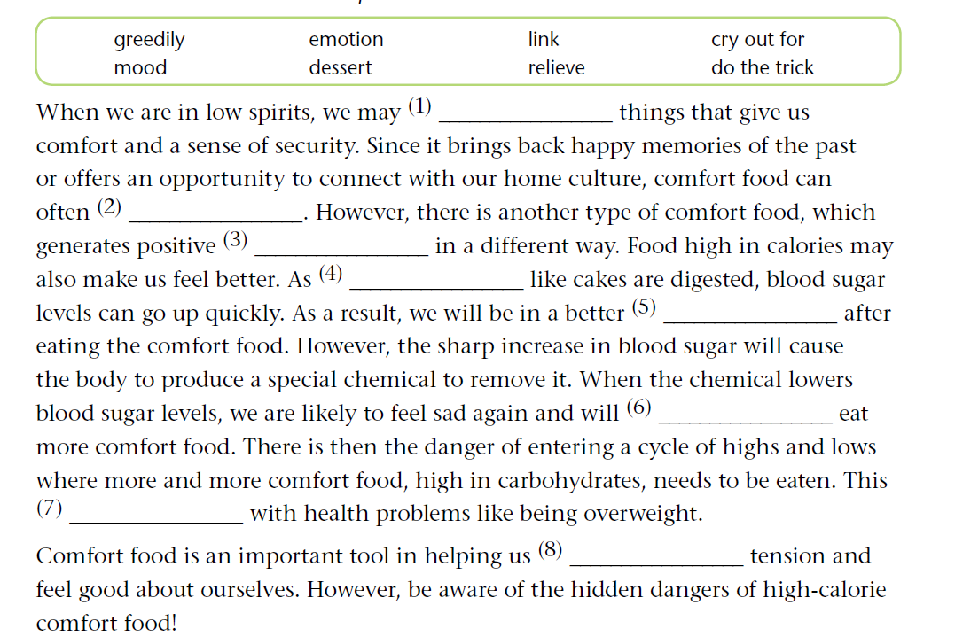
Filling blanks

Slide 10
Filling blanks
Answers:
(1) cry out for (2) do the trick
(3) emotions (4) desserts (5) mood (6) greedily
(7) is/has been linked
(8) relieve

Slide 11


Match
Column A Column B
cheer up make up for give up take up keep up set up show up | A. 出现，露面 B. 放弃，交出 C. 开始从事 D. 保持，继续 E. 弥补 F. 搭建 G. 振奋
G
E
B
C
D
F
A

Slide 12
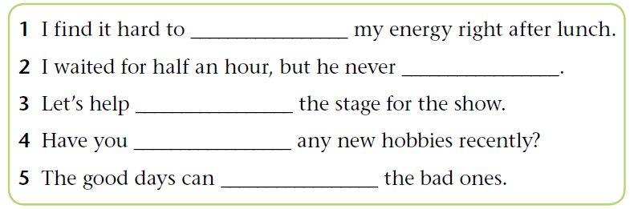
Match
Answers:
1. keep up 2. showed up 3. set up
4. taken up 5. make up for

Slide 13


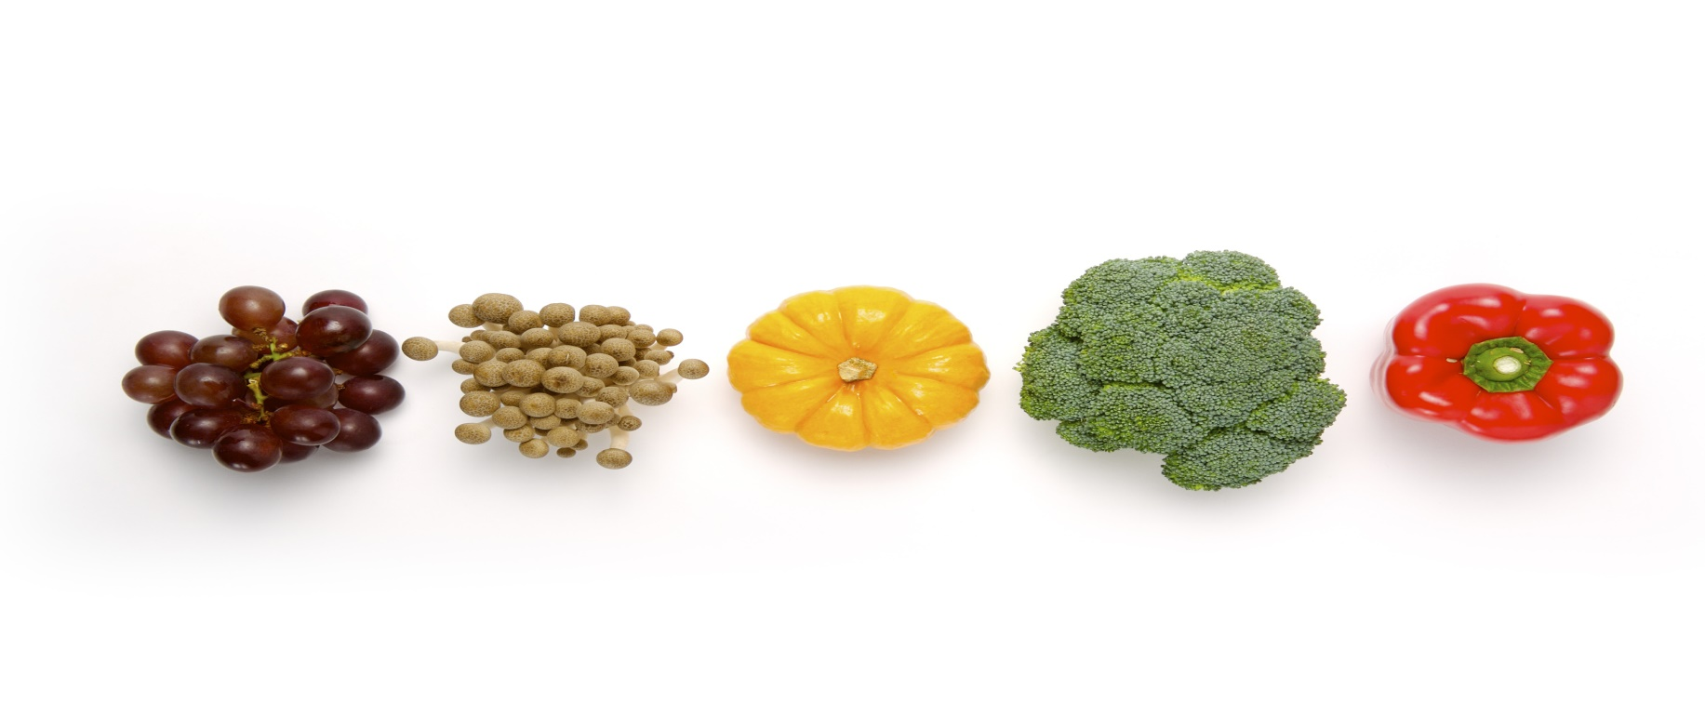
competition
Think of more phrasal verbs with “up” and make sentences with them on the Bb.

Slide 14

Micro-writing
你们学校下周将举行校园饮食节，你想邀请你正在中国留学的英国朋友来参加，请写一封邀请信。
内容包括：1. 时间，地点；
2. 中国传统食物；
3. 目的和意义。
Dear Smith
Knowing you are interested in traditional Chinese food, I am writing to invite you to come to our Food Festival ...

Slide 15


Homework
Polish your writing.

Slide 16


