Slide 1
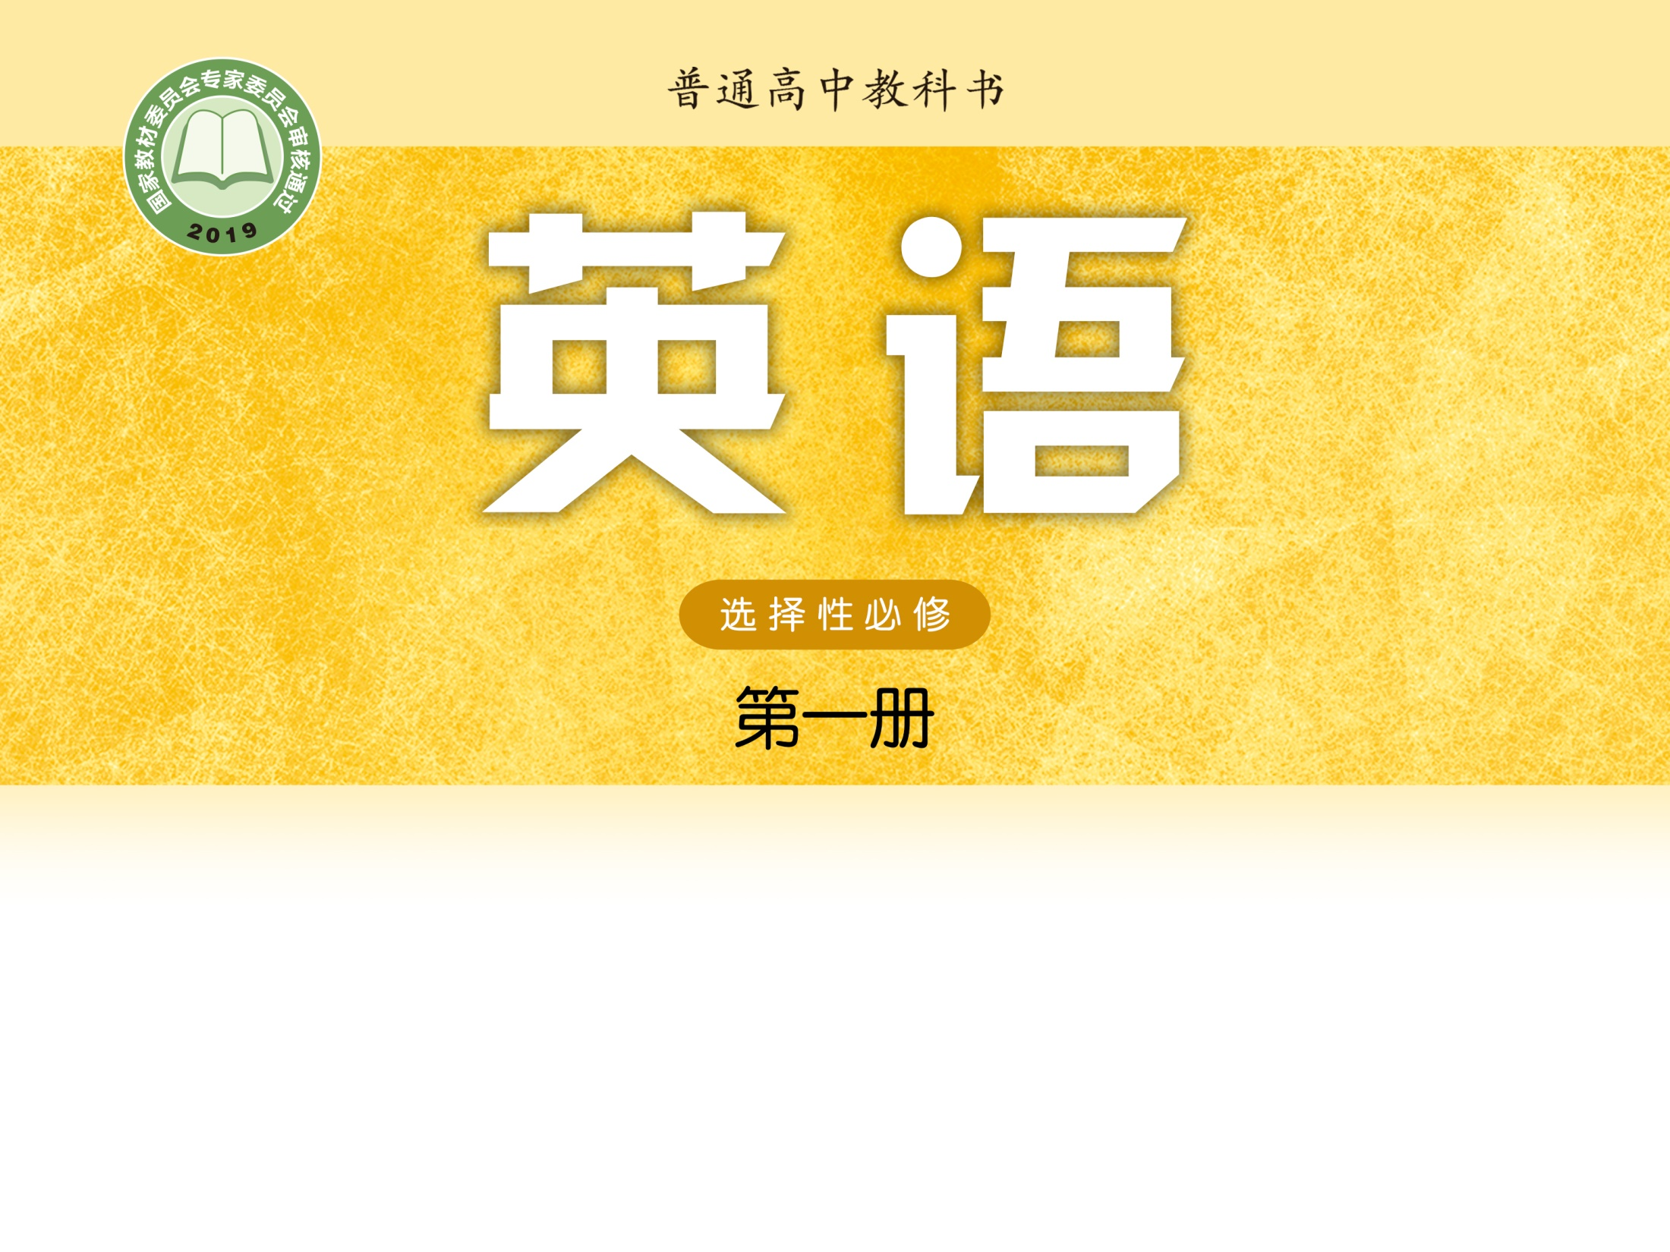
Unit 1 Food matters
Welcome to the unit & Reading (I)
段志梅 湖南省株洲市九方中学

Slide 2


段志梅
中小学一级教师
指导学生参赛，多次获得国家级荣誉
2016、2020年度“一师一优课，一课一名师”市级优课
荣立株洲市三等功
株洲市优秀党员

Slide 3

Step 1 Lead-in
When you feel unhappy, what will you do?

Slide 4
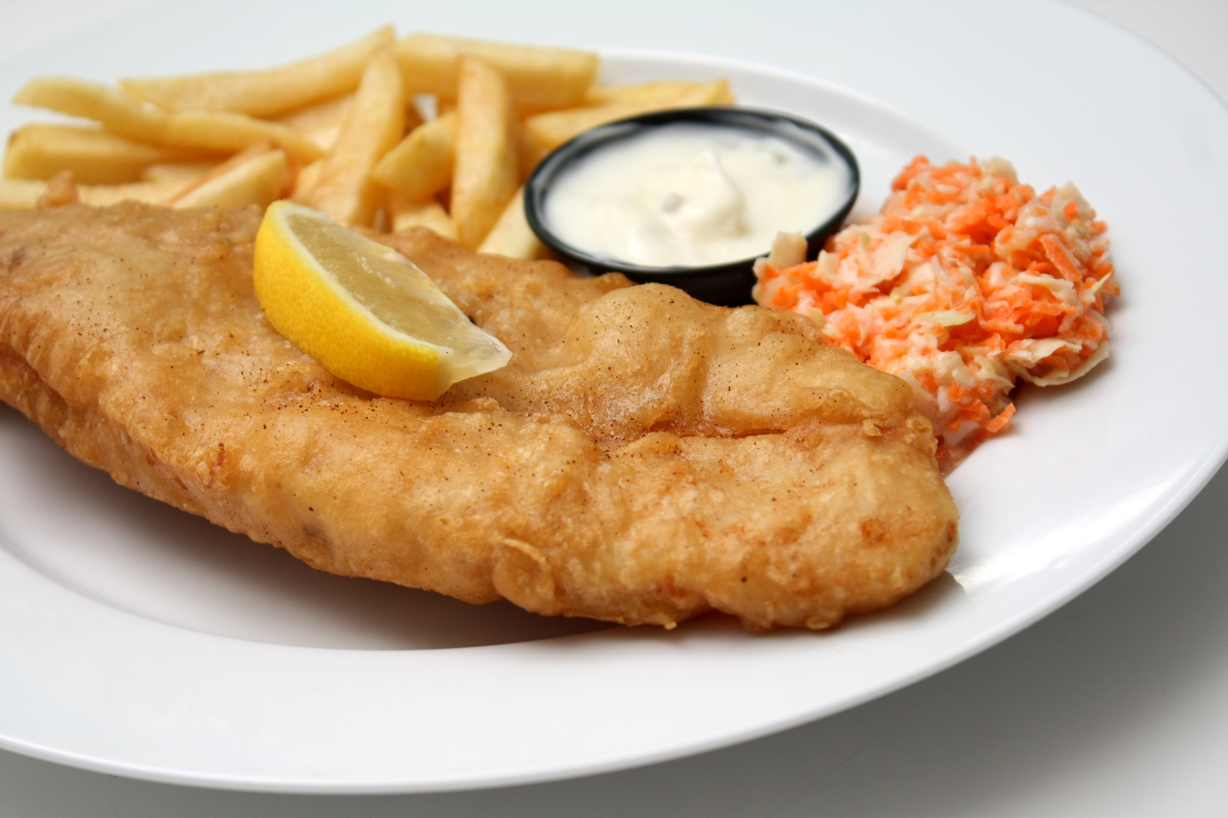
Each country has its typical food.
Watch the video!

Slide 5
Each country has its typical food.
• Fish and chips from the UK consists of deep-fried fish and _____________ chips.
• Sushi from Japan comes in _________________ and is very popular partly because of its freshness and convenience.
• A taco, a traditional Mexican dish, is made up of a _________ or wheat pancake rolled around a filling.
• Pasta from Italy is typically made from flour, water and sometimes _______.
fat golden
all shapes and sizes
corn
eggs

Slide 6
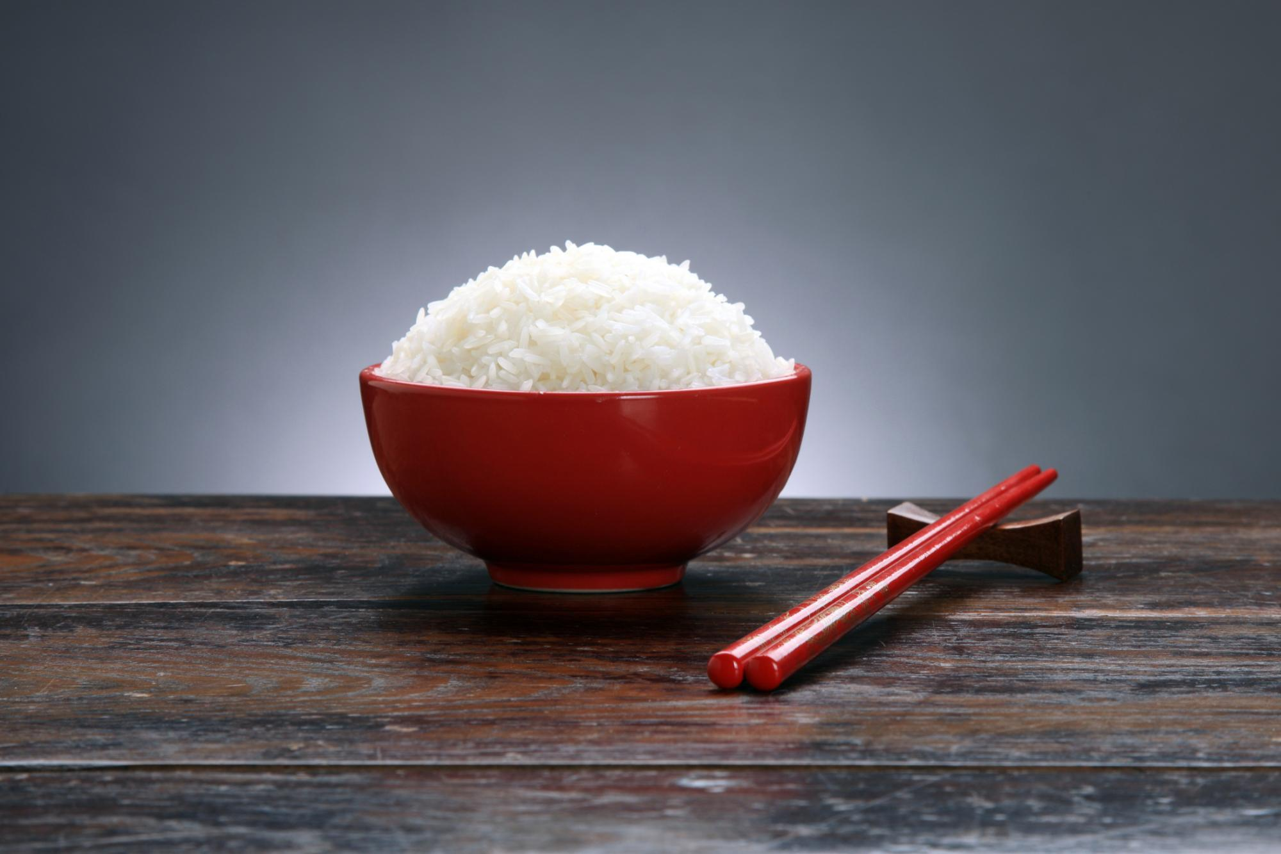
Answer the questions:
• Which of the dishes in the video would you like to try most? Why?
• What do you think is the most typical Chinese food?
• What foods can have an impact on your feelings?

Slide 7
• Which of the dishes in the video would you like to try most? Why?
• What do you think is the most typical Chinese food?
• What foods can have an impact on your feelings?
I want to try the Japanese sushi most. It looks colourful and delicious.
I think the most typical Chinese food is baozi, a type of steamed bun. It has different fillings, including meat and vegetables. Chinese people usually have baozi for breakfast, together with soya milk.
Dumplings cheer me up because they remind me of the time when I was younger and helped my mom to make them.

Slide 8




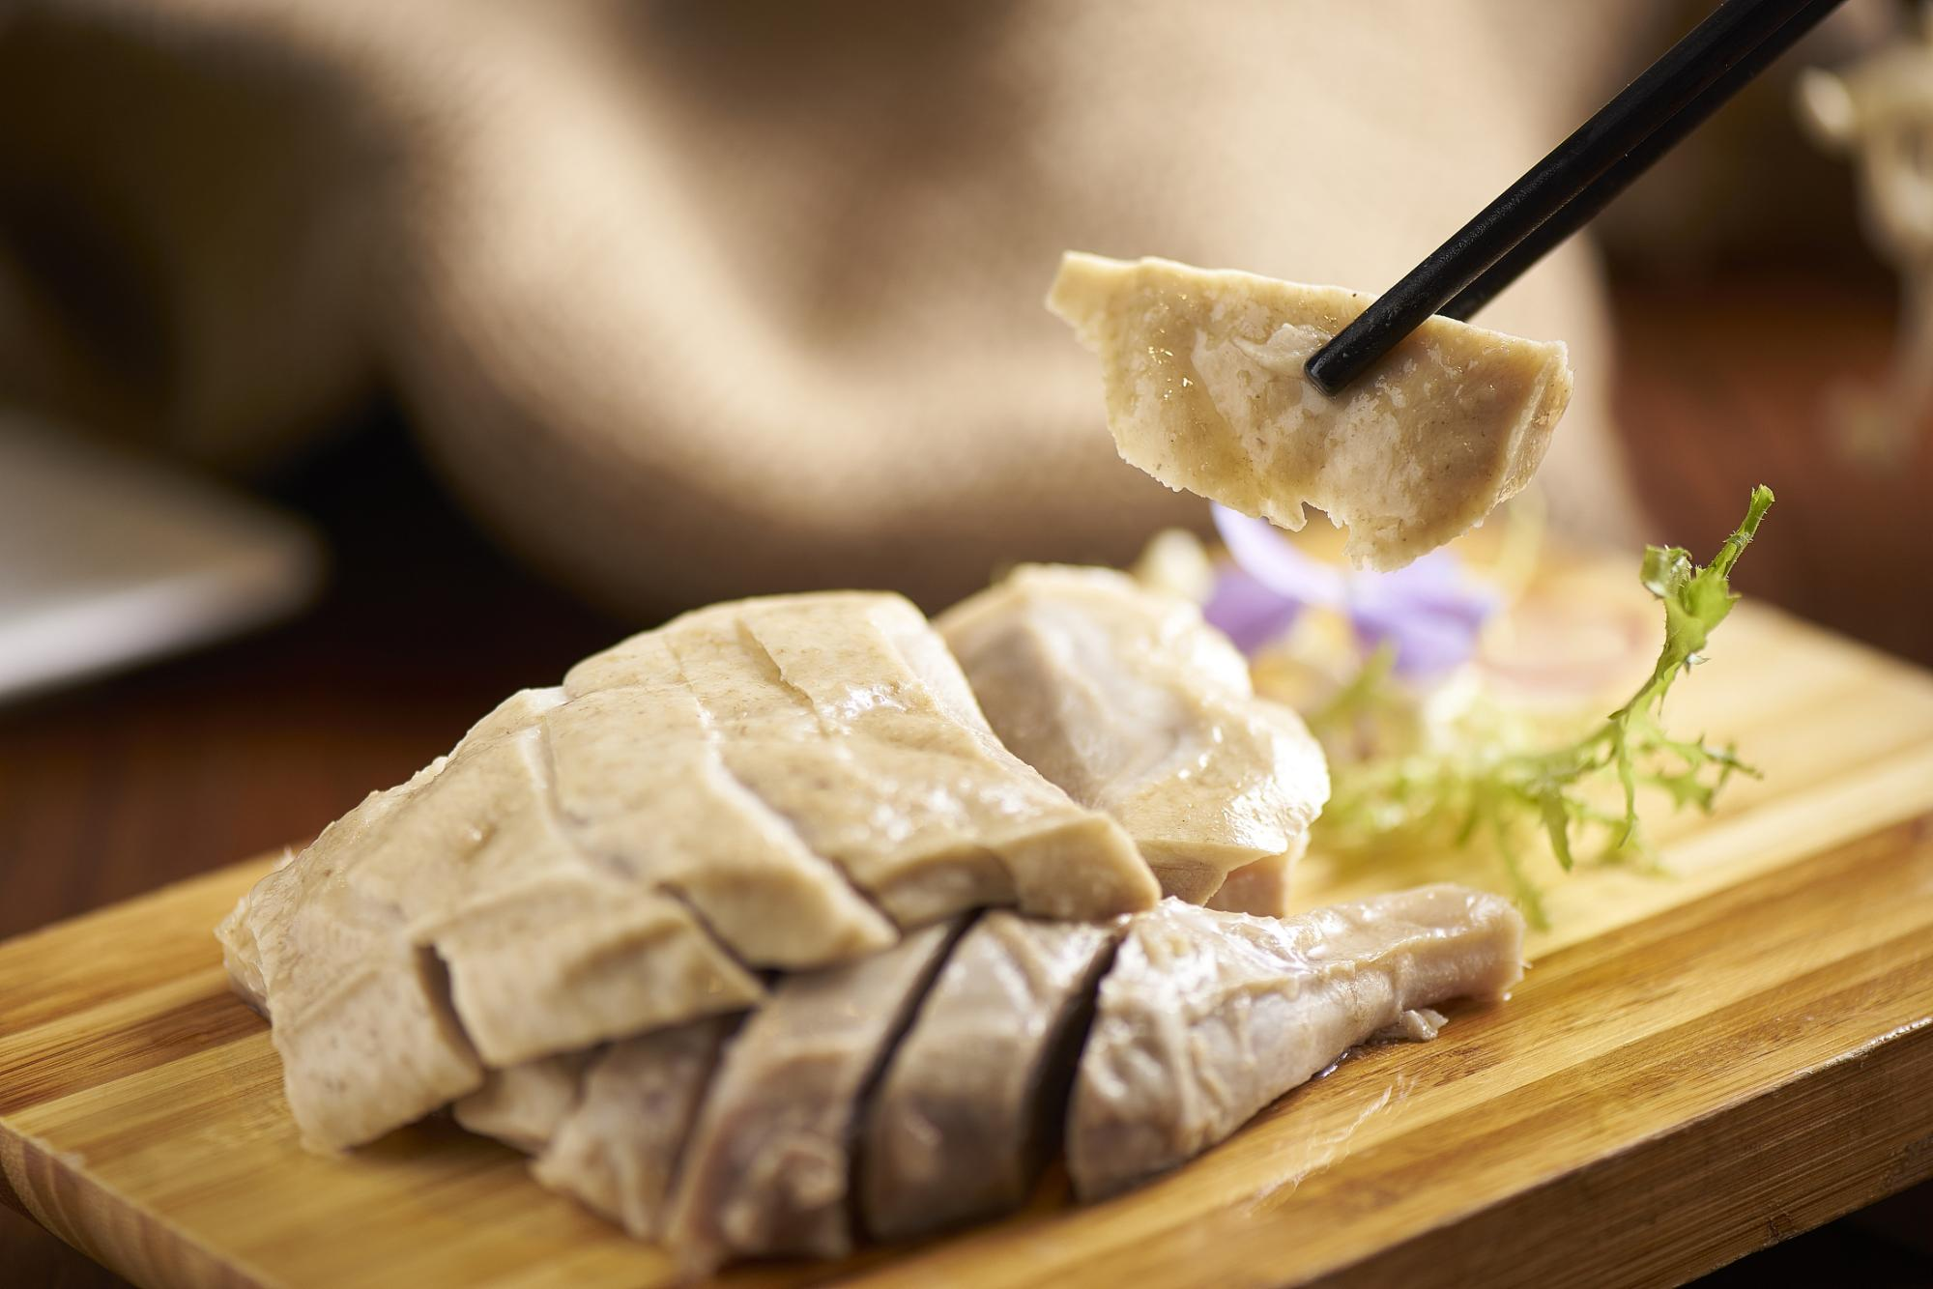
Step 2 Understanding the structure
A
Choose the right answer!

Slide 9
Para. 1: Rice pudding cheers me up whenever I feel unhappy.
Para. 2: Comfort food has the unique power to make us feel better.
Para. 3: Our comfort foods are highly individual, depending on our unique experiences.
Para. 4: Comfort food gives the “taste of home” to people who feel homesick when they move to a new country.
Para. 5: Comfort food is food for the soul.

Slide 10
Step 3 Reading for specific information
1. What does the author compare the flavour of the rice pudding to in the first paragraph?
2. What is comfort food in its broadest sense?
3. According to the third paragraph, how does comfort food such as chicken soup cheer us up?
4. For people who move away from their home country, what largely determines their comfort food?

Slide 11
Step 3 Reading for specific information
1. What does the author compare the flavour of the rice pudding to in the first paragraph?
2. What is comfort food in its broadest sense?
3. According to the third paragraph, how does comfort food such as chicken soup cheer us up?
A time machine that transports the author back to her sunny childhood.
Any food that make us feel better.
By connecting with our happy childhood and being tied up with the feeling of being taken care of.

Slide 12
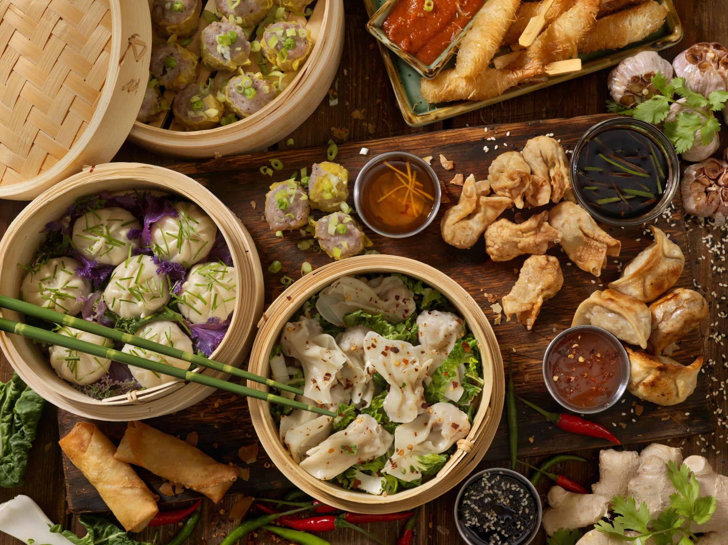
4. For people who move away from their home country, what largely determines their comfort food?
Where they come from.

Slide 13
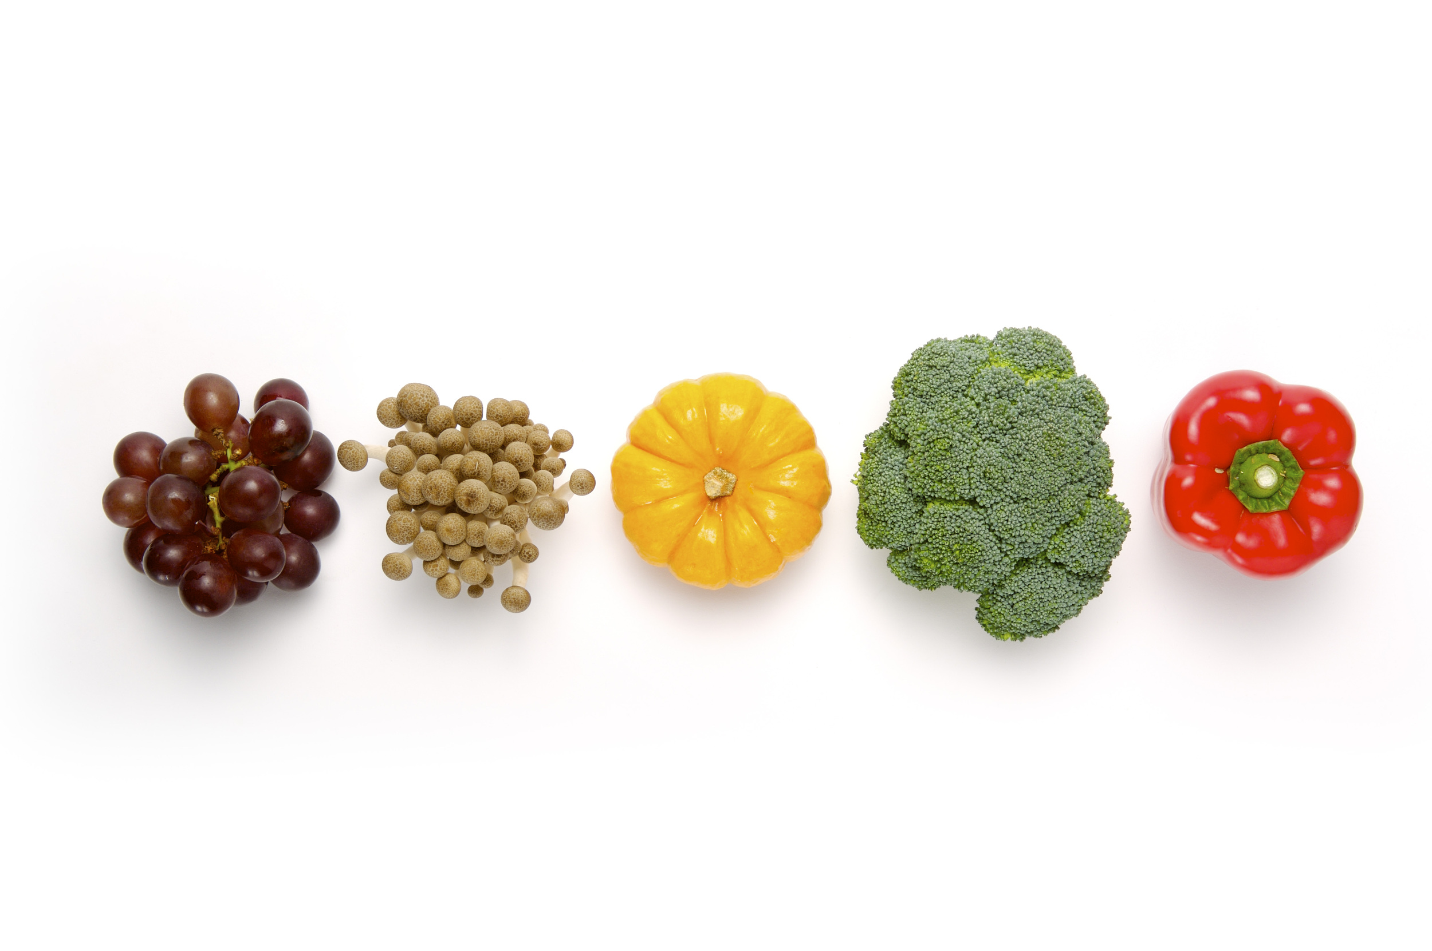
Step 4 Further reading
• How does the author introduce the topic of comfort food? What do you think of this technique?
• In your opinion, is there any difference between one’s comfort food and favorite food? Give your reasons.
• Recommend some comfort food and give your reasons.

Slide 14
• How does the author introduce the topic of comfort food? What do you think of this technique?
• In your opinion, is there any difference between one’s comfort food and favorite food? Give your reasons.
The author introduces the topic with a personal experience from her childhood that illustrates the power comfort food has to lift our spirits, before continuing with a more detailed description of exactly how comfort food does that. This technique is quite effective , as it attracts the reader’ s attention and inspires interest in the topic of discussion.
I think people’s favourite food and comfort food are different in two ways. First, people’s favourite food can come and go, while their comfort food often remains the same. Second, people’s favourite food often connects with satisfying their hunger, while comfort food usually connects with memories from their childhood.

Slide 15
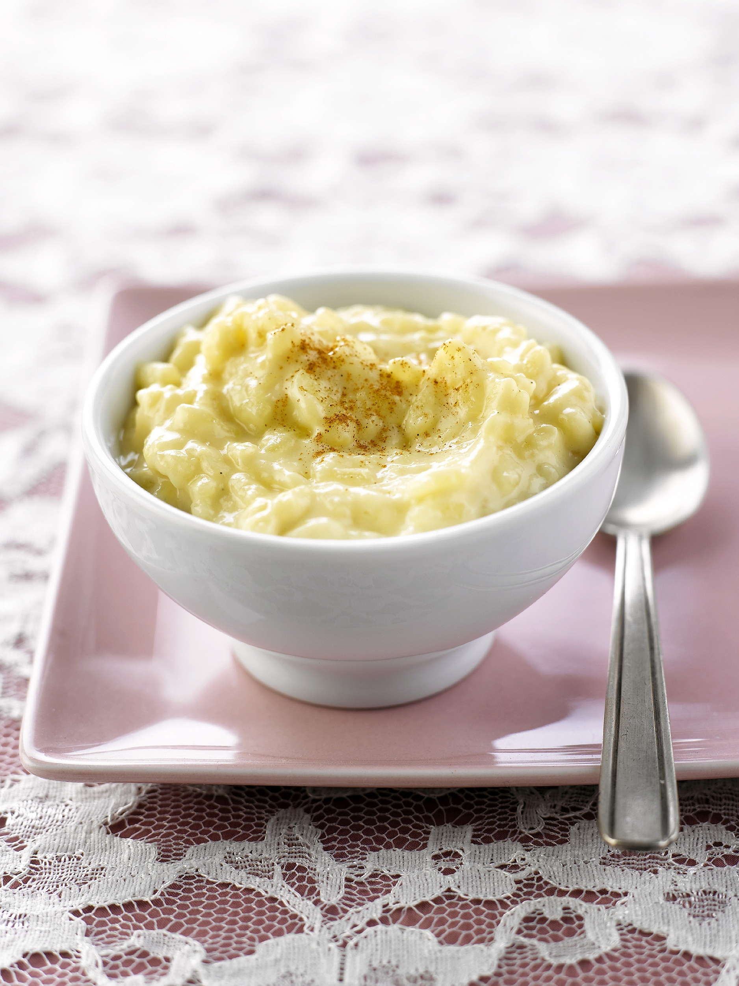

Let’s share!
Recommend some comfort food and give your reasons.

Slide 16
Summary
Comfort food let us touch our tongue. However, the most important thing is that it is more than a kind of food. It’s food for the soul. We can express our feelings through it. As Chen Shou says, “Food is as fundamental to man as the people are to the state”. (国以民为本，民以食为天。) By eating comfort food, we can keep a positive attitude towards our life.

Slide 17
Homework
1. Read the magazine again and underline the difficult points that you cannot understand.
2. Are there any other information about comfort food? What are they? Go to the library or surf the Internet to collect some relevant information and share them with your classmates.

Slide 18


